Slide 1
Tutorial 10
AWS Deployment
CS551 Advanced Software Engineering
UMKC

Slide 2
Topics to cover
Amazon AWS
AWS Elastic Beanstalk

Slide 3
AWS Introduction
Amazon Web Services (AWS), is a collection of cloud computing services, also called web services, that make up a cloud-computing platform offered by Amazon.com.

Slide 4
AWS Introduction
AWS is a collection of services in the cloud, as the definition says.
AWS provides fast computing resources online (for example, you need 10 minutes to set up a Linux server).
AWS offers affordable fees. AWS provides easy-to-use services out of the box, which is saves lots of time manually setting up a database, cache, storage, network and other infrastructure services.
AWS is always available and is highly scalable.

Slide 5

Account Creation

Slide 6
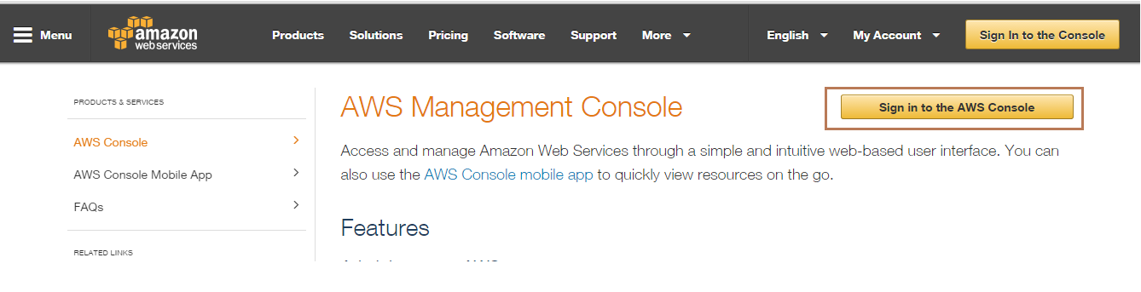
AWS - Console
Open the URL : https://aws.amazon.com/
Notes:
References: https://aws.amazon.com/console/

Slide 7
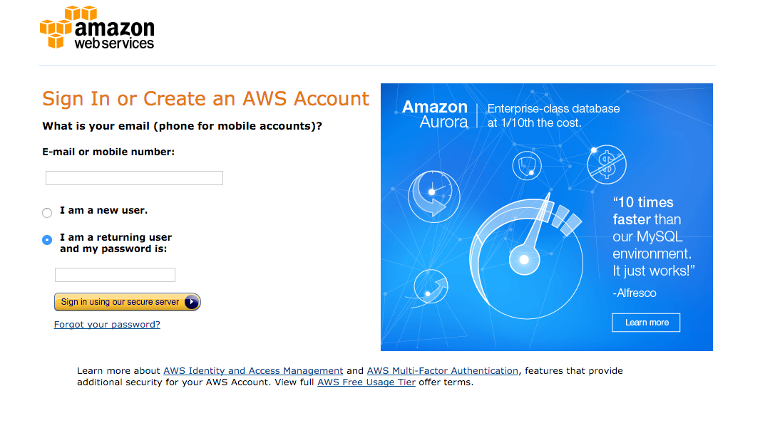

Slide 8
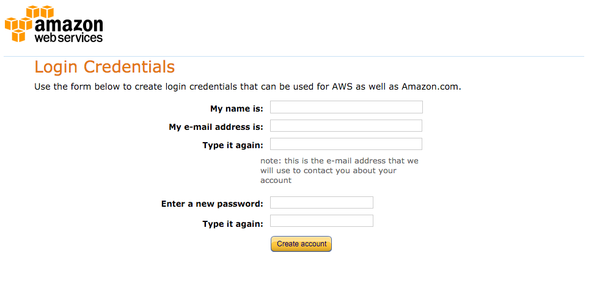
Fill in the details to create account.

Slide 9
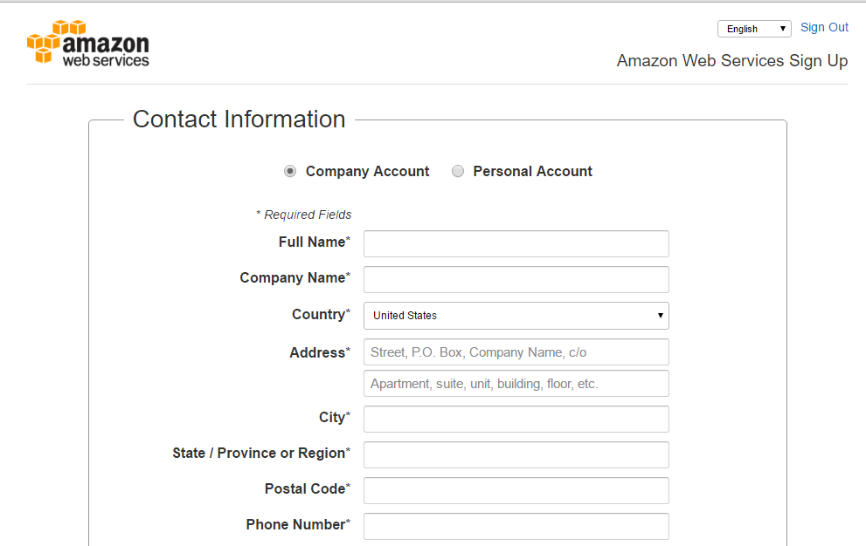

Slide 10
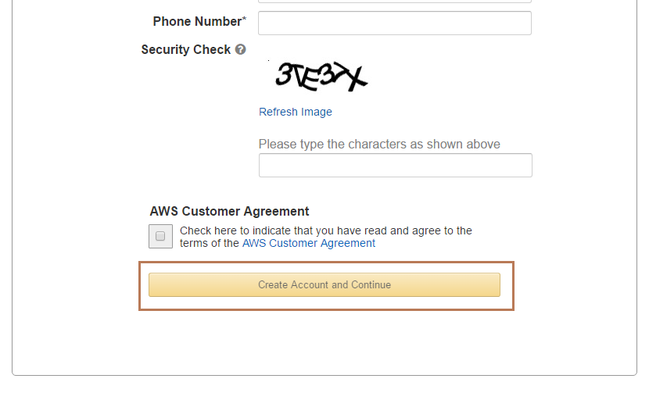
You will receive a signup confirmation after creating account

Slide 11
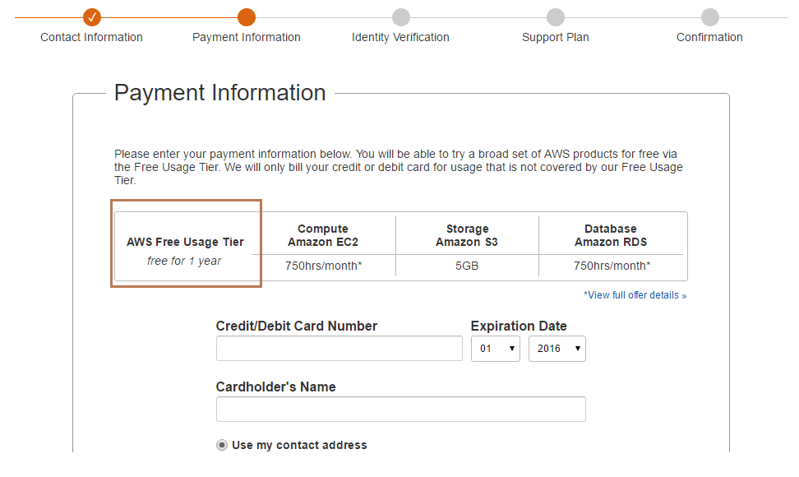
AWS Console-Signup
Make sure you have the Free Usage Tier

Slide 12
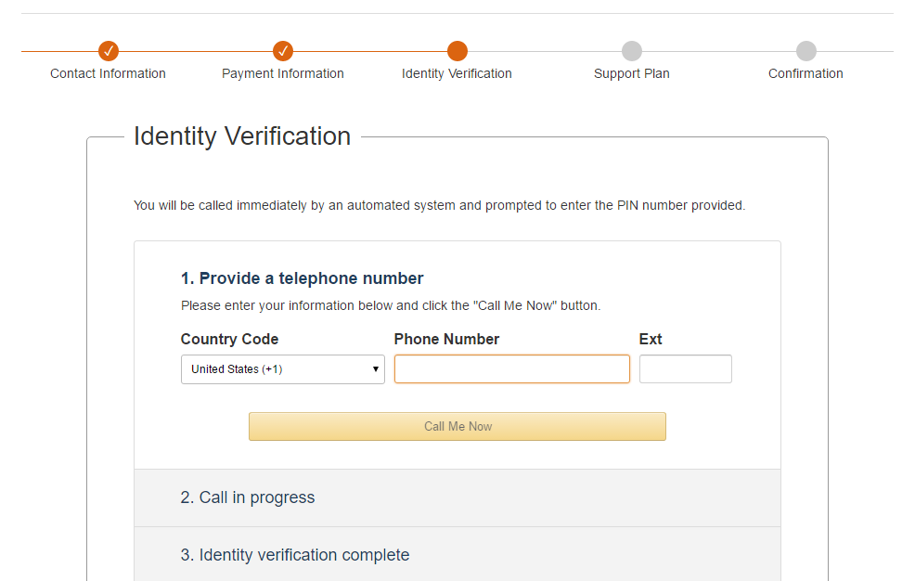

Slide 13
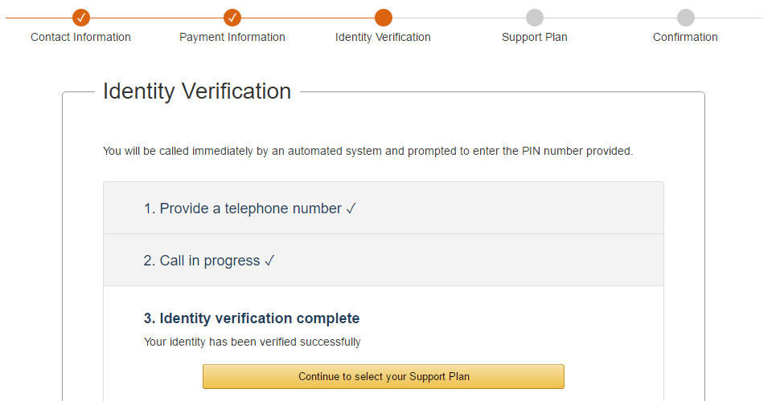

Slide 14
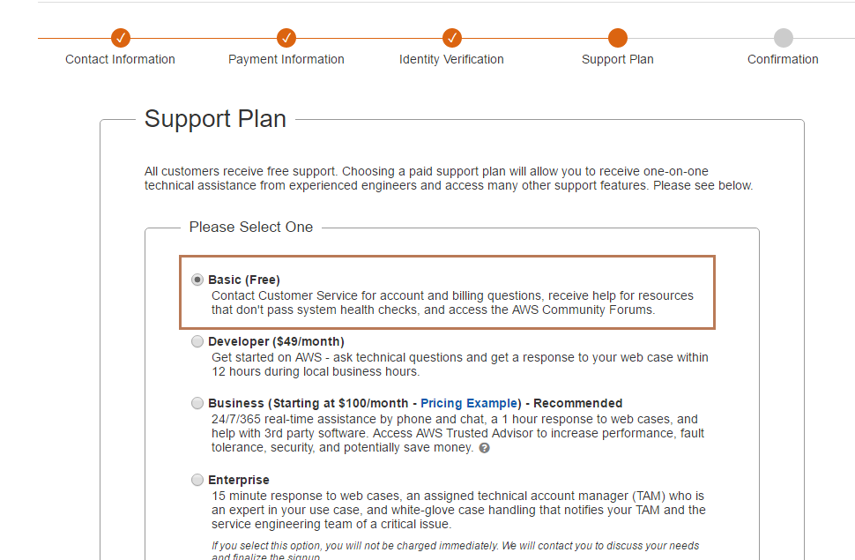

Slide 15
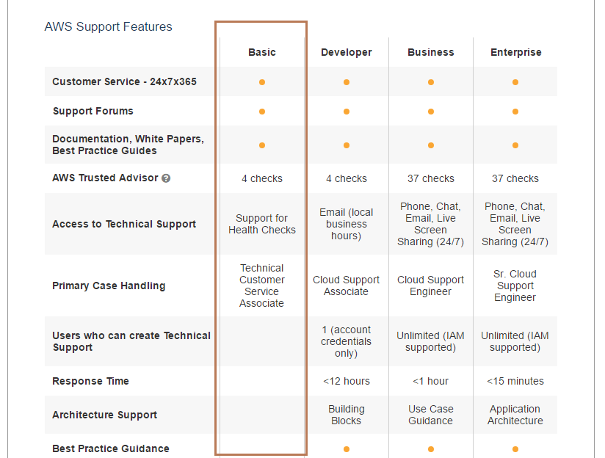
The service gets activated after 24 hours and a confirmation will be sent to your email.

Slide 16
AWS Elastic Beanstalk

Slide 17
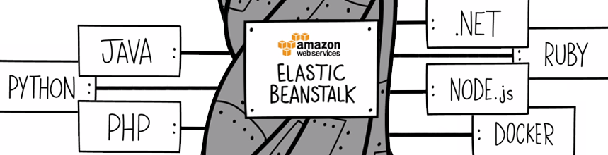
Elastic Beanstalk

Slide 18
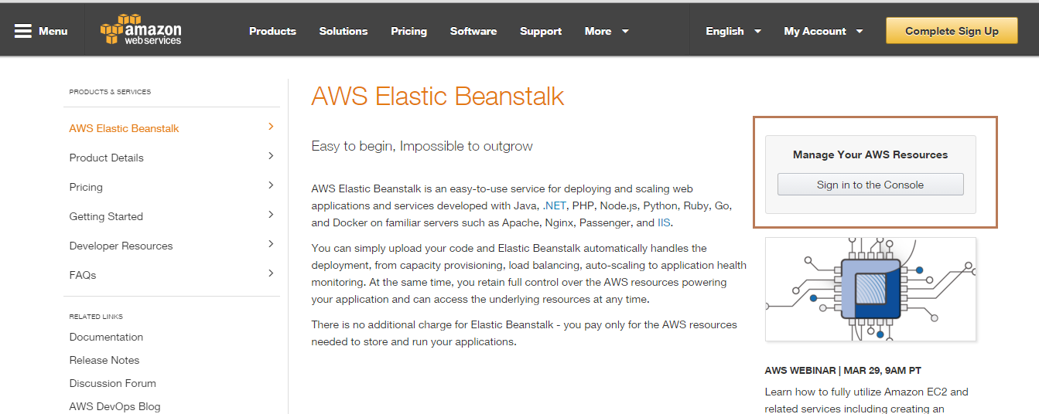
Open the URL : https://aws.amazon.com/elasticbeanstalk/

Slide 19
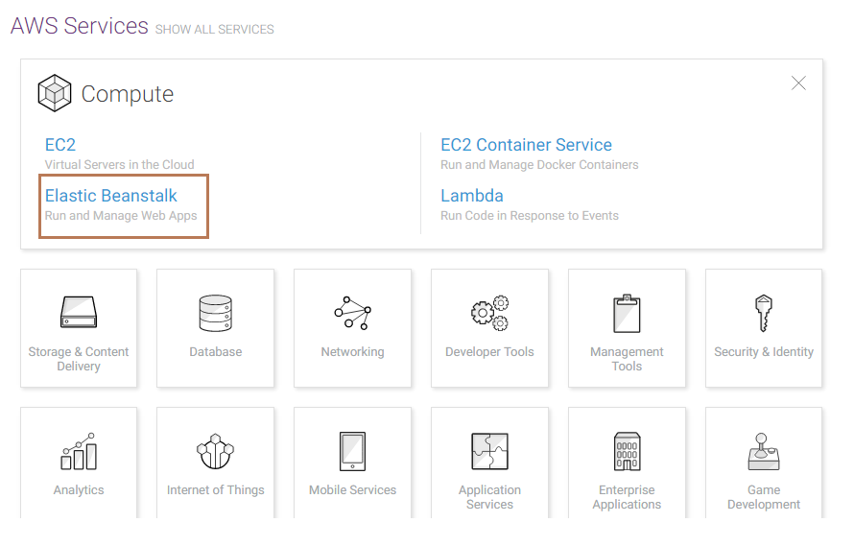
AWS Console - Elastic Beanstalk

Slide 20
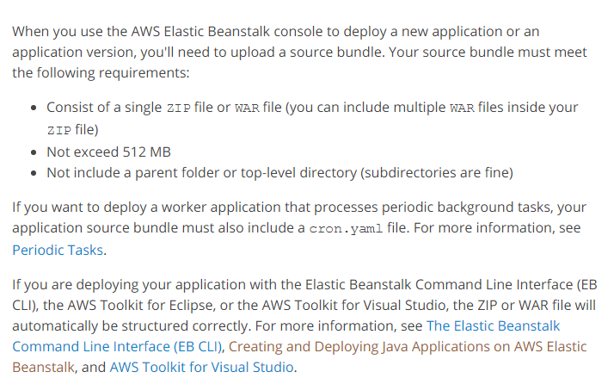
JAVA on Elastic Beanstalk

Slide 21
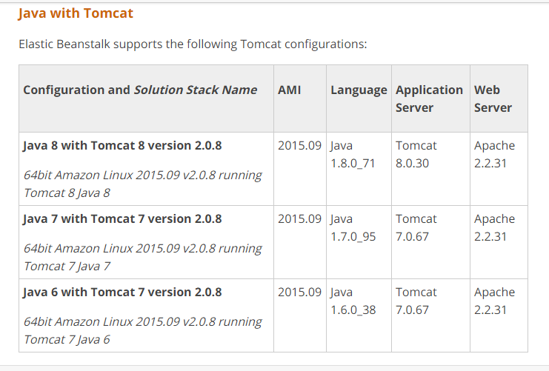
Supported Platforms

Slide 22
Structuring your JAVA application
~/workspace/my-app/ |-- build.sh - Build script that compiles classes and creates a WAR |-- README.MD - Readme file with information about your project, notes |-- ROOT.war - Source bundle artifact created by build.sh `-- src - Source code folder |-- WEB-INF - Folder for private supporting files | |-- classes - Compiled classes | |-- lib - JAR libraries | |-- tags - Tag files | |-- tlds - Tag Library Descriptor files | `-- web.xml - Deployment Descriptor |-- com - Uncompiled classes |-- css - Stylesheets |-- images - Image files |-- js - JavaScript files `-- default.jsp - JSP (JavaServer Pages) web page
Notes:
References: http://docs.aws.amazon.com/elasticbeanstalk/latest/dg/java-tomcat-platform-directorystructure.html

Slide 23
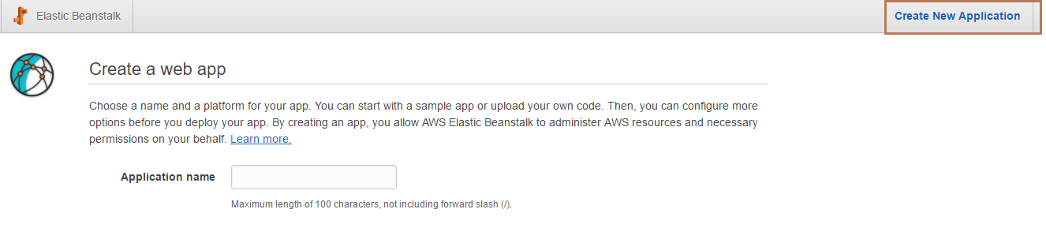
Deploying an application to Elastic Beanstalk
Open the Elastic Beanstalk console
On the Elastic Beanstalk application navigation bar, click Create New Application.

Slide 24
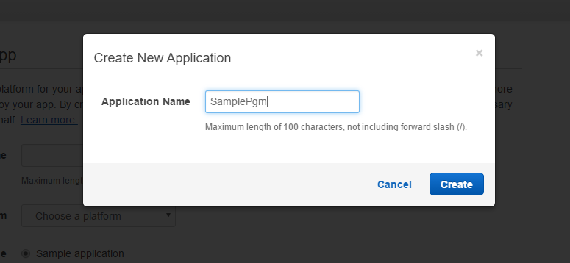
Enter the name of the application and, Then click Create.

Slide 25
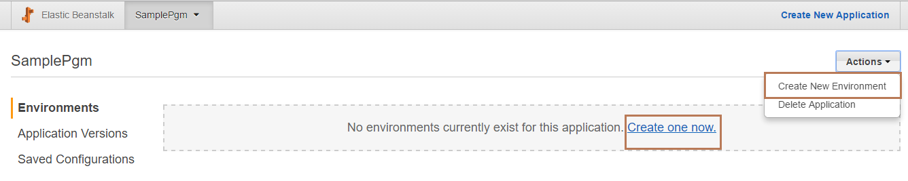
In the upper right corner, choose Create a New Environment.

Slide 26
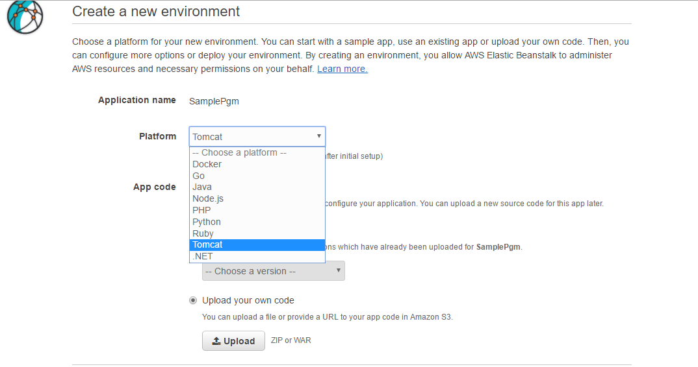
5. From the drop down menu select Tomcat under platform and select the option Upload your own code where the WAR or ZIP is to be uploaded.

Slide 27
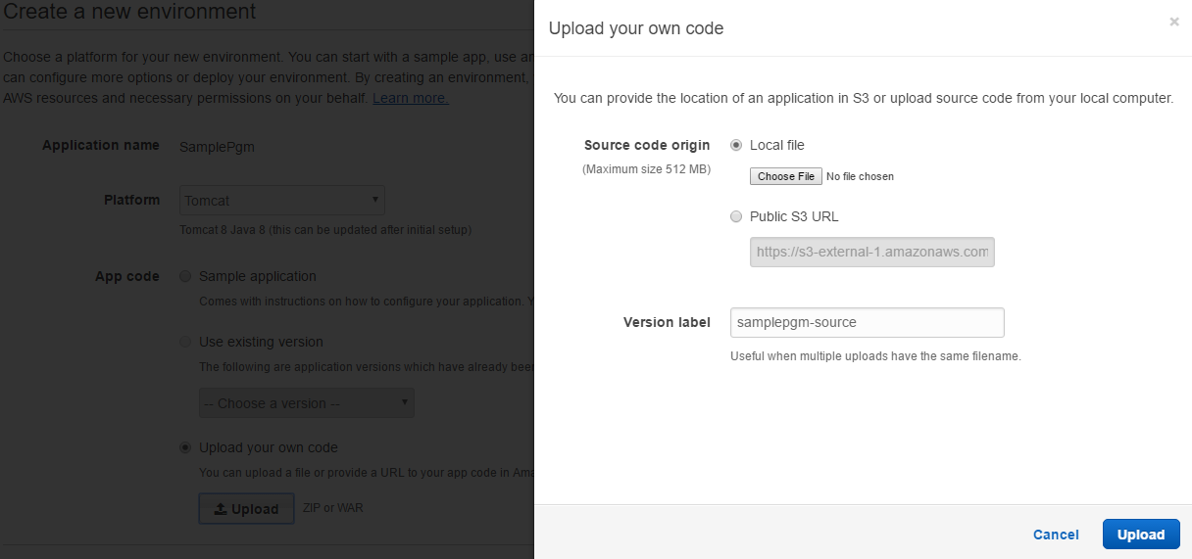
6. Choose Sample Application or Upload your own and upload an application source bundle.

Slide 28
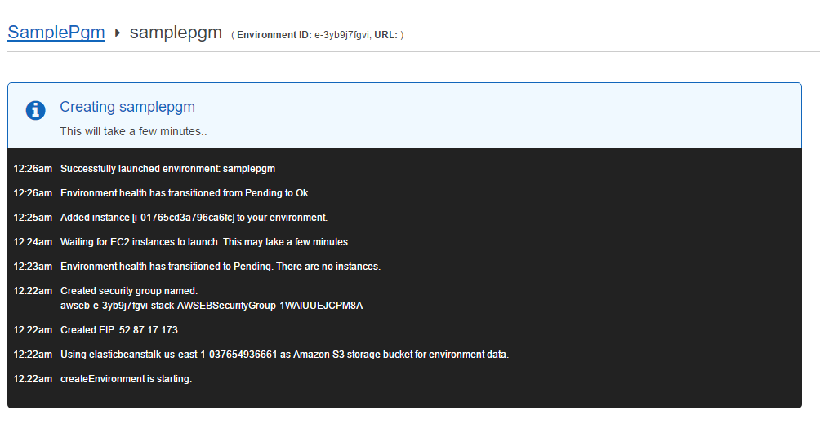

Slide 29
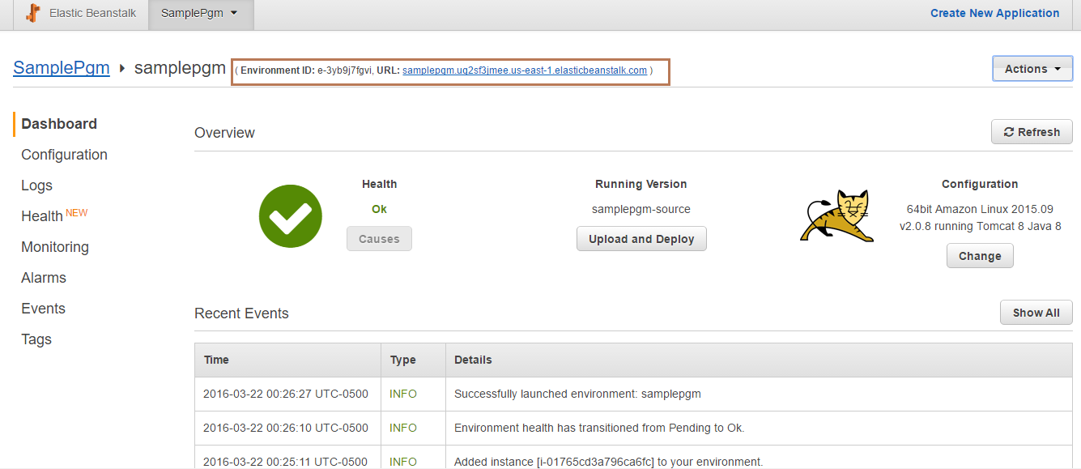

Slide 30
Generating and Uploading war file
Download the source code from http://www.mkyong.com/webservices/jax-rs/resteasy-hello-world-example/

Slide 31
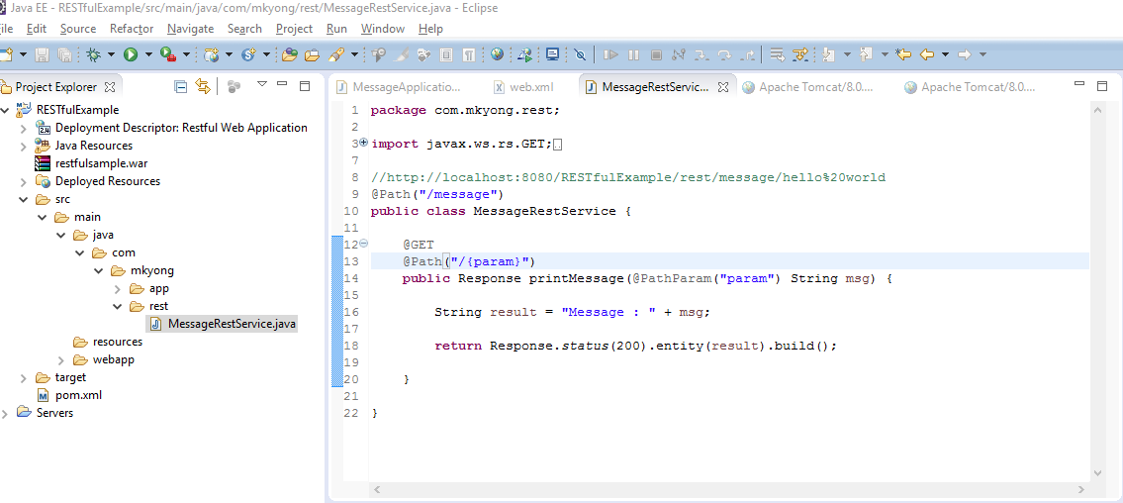
Sample Java REST App

Slide 32
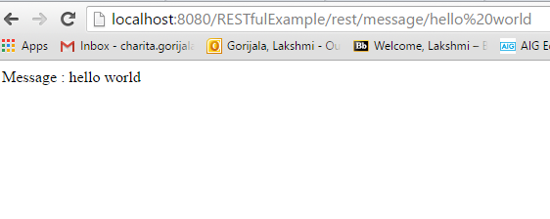
Local Run

Slide 33
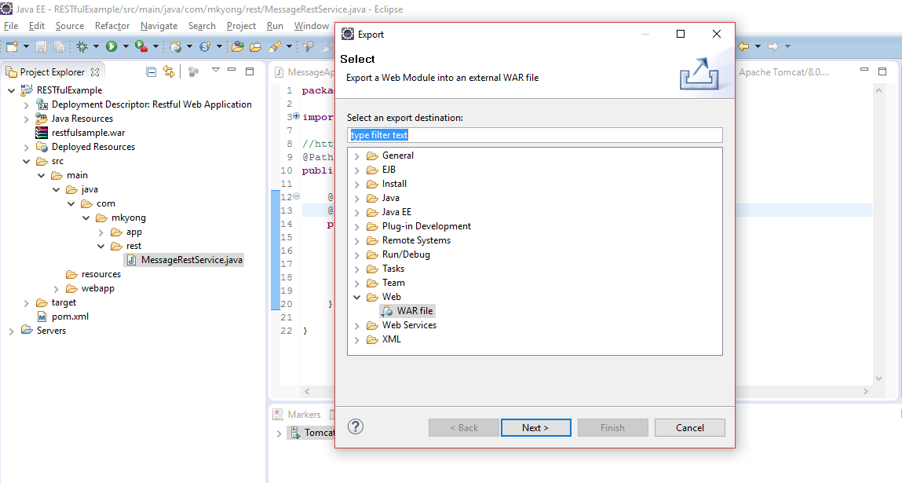
Generate WAR file from Eclipse

Slide 34
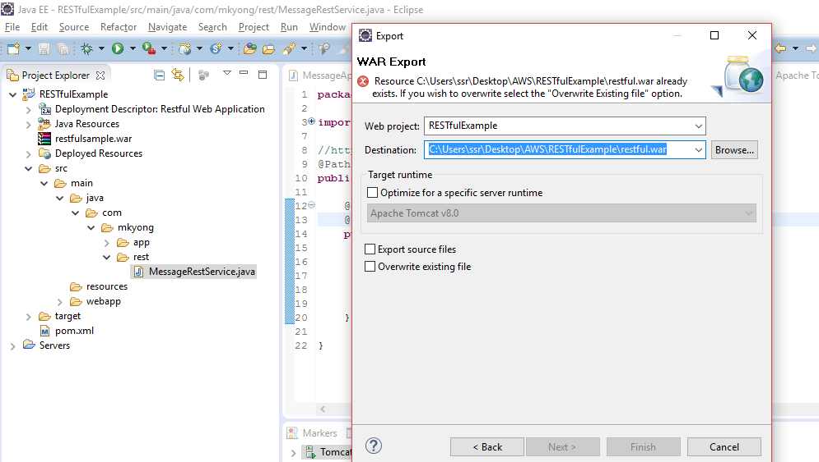

Slide 35
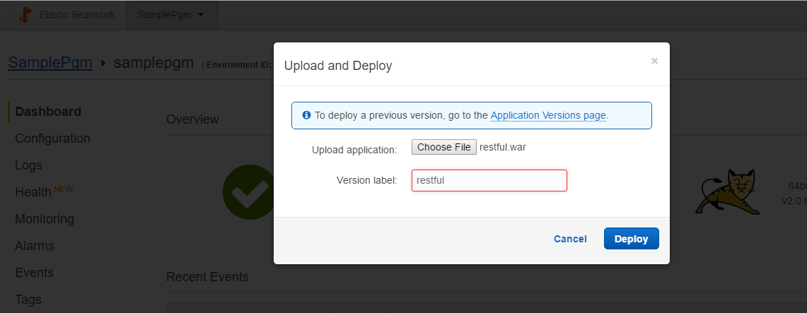
Upload and Deploy the WAR file

Slide 36
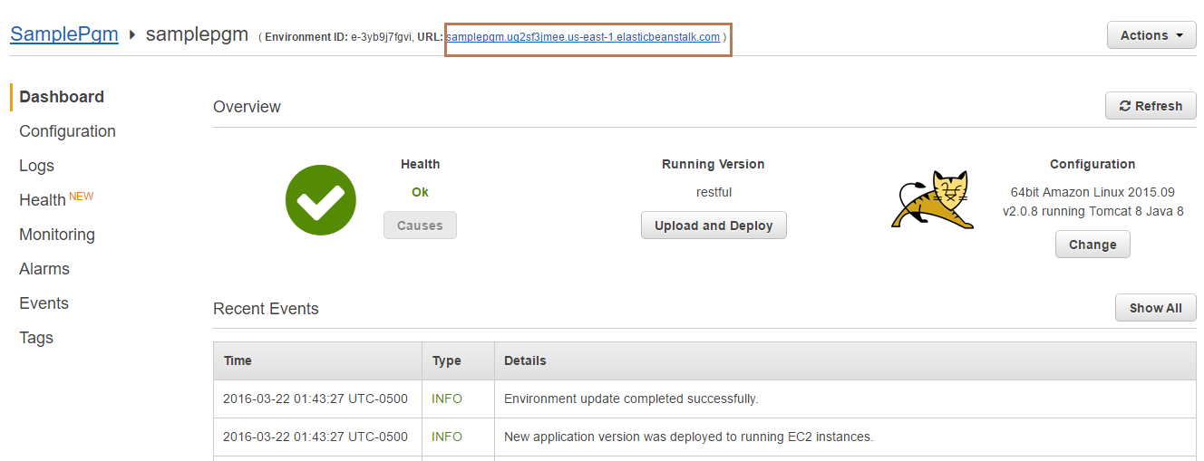
Deployment Successful

Slide 37
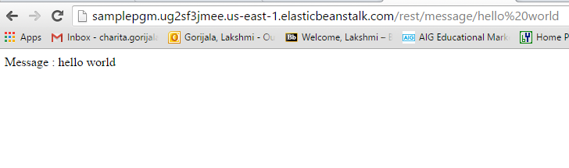
Test the url

Slide 38
Task
Deploy your applications onto your Amazon instances and share the URL.
Submit the code under the Source folder in Github.

Slide 39
References
https://www.toptal.com/aws/boost-your-productivity-with-aws
https://aws.amazon.com/elasticbeanstalk/
http://www.mkyong.com/webservices/jax-rs/resteasy-hello-world-example/

Slide 40
Review : All Tutorials

Slide 41
Architecture
Amazon AWS
Mobile App
(Ionic/Native Android/iOS app)
MongoDB
Web Server
(Tomcat, Websphere)
Web App (war file)
Everything together makes more sense..

Slide 42
Review
Git + ZenHub + Visio + Creately
HTML5, CSS, Javascript, JSLint
Angular JS
Android (Android Studio, Android SDK, AVD, Gradle, Jargon like Activity, Intent, Fragments, layouts, drawable etc)
Servlets, WebSphere, Unit testing
REST : Servlets with MongoDB
Hybrid app : Ionic basics and unit testing
Ionic plugins and performance testing
Amazon WS

Slide 43
Log.w(“TAs Message”, “THANK YOU”);

